Slide 1


Practical Aspects in Ventilator-Associated Pneumonia (VAP) Prevention
HKSCCM Annual Scientific Meeting 2013
Dr Arthur Chun-Wing Lau
Associate Consultant, ICU, Pamela Youde Nethersole Eastern Hospital
8th December, 2013

Slide 2
The following will be discussed
How much attention are we paying to VAP?
How did our ICU deal with a high VAP rate and successfully bring it down?
Results of a recent research of our group on novel ETTs
A short literature review of VAP publications in 2013

Slide 3
How much attention are we paying to VAP?
Are the following conditions equally important?
Incidence: 0.5 per 1000 device-days, attributable mortality: 9.4% (n=74585, Olaechea PM et al, Rev Esp Quimioter 2013)
Incidence: 1 to 12.5 per 1000 device-days, attributable mortality: 13% (n=6284, Nelson WG et al, Lancet Infect Dis 2013)
CABSI
VAP

Slide 4
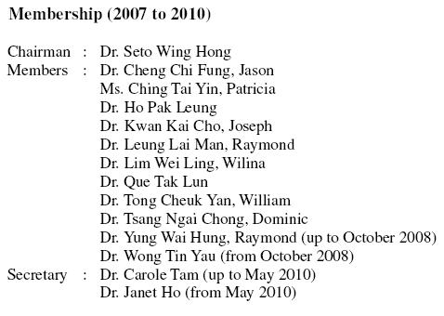
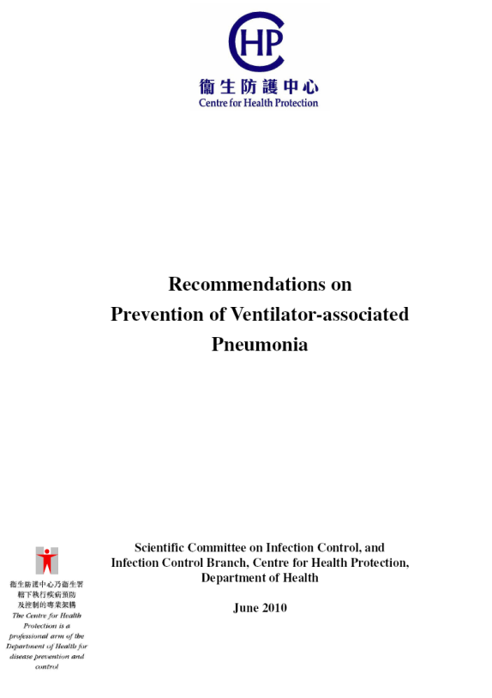
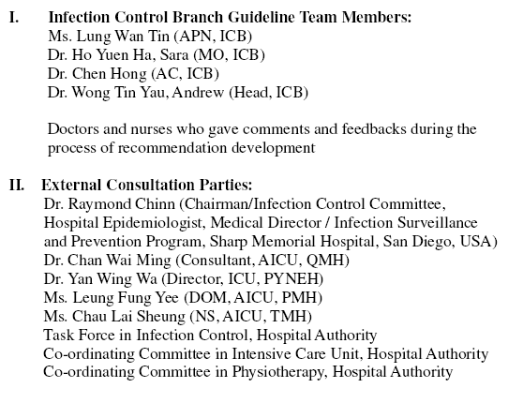

Slide 5
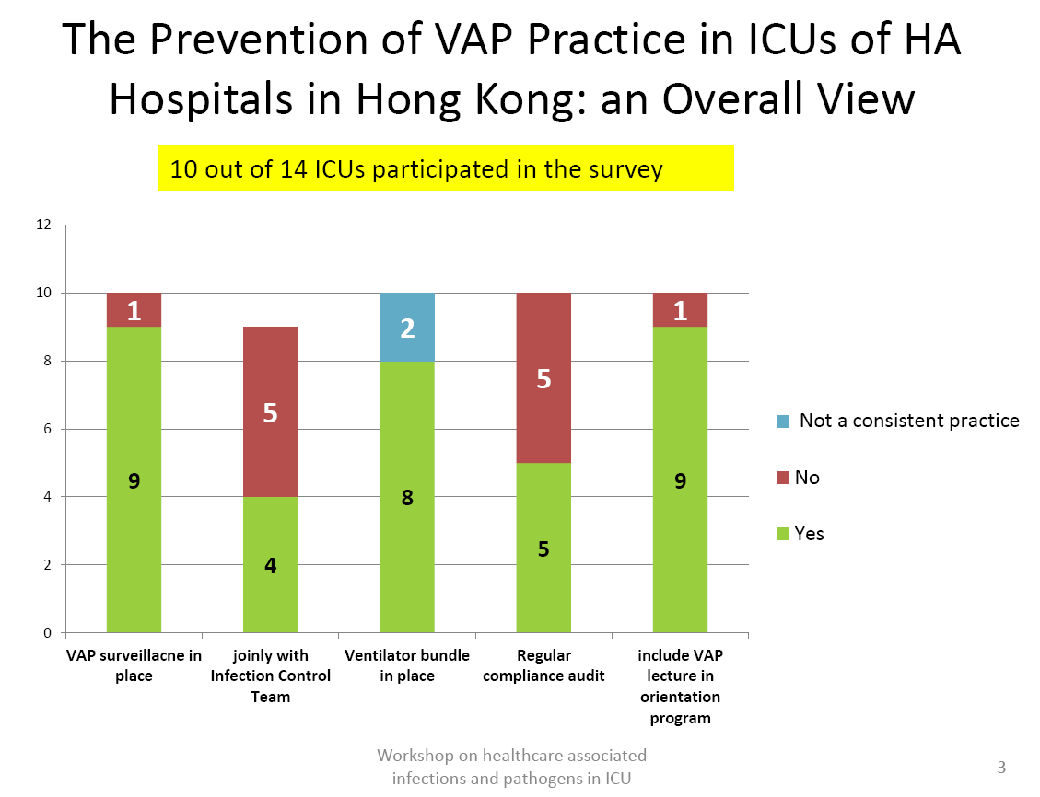

Slide 6
Attributable mortality of ventilator-associated pneumonia: a meta-analysis of individual patient data from randomised prevention studies
Individual patient data were available for 6284 patients from 24 trials.
The overall attributable mortality was 13%, with higher mortality rates in surgical patients and patients with mid-range severity scores at admission (ie, APACHE 20 to 29 and SAPS 2 35 to 58).
Attributable mortality was close to zero in trauma, medical patients, and patients with low or high severity of illness scores.
Melsen WG et al. The Lancet Infectious Diseases, Volume 13, Issue 8, Pages 665 - 671, August 2013

Slide 7
VAP has to be a Key Performance Indicator (KPI)
Audit of the management of Intensive Care (ICU) services within the Hospital Authority Nov 2013 (Draft)
  Point 1.5.4, page 18: “… all units should be monitoring aspects of care quality, such as ventilator acquired pneumonia (VAP), regardless of the types of patients they treat ….”
The German quality indicators in intensive care medicine 2013 – second edition
  “VAP is of utmost importance in intensive care medicine. Avoidance of VAP has become a central quality indicator in the USA.”

Slide 8



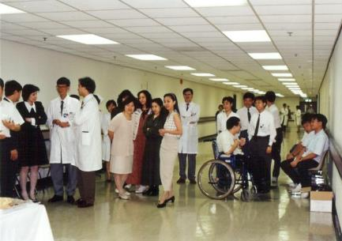

PYNEH ICU
1993 – PYNEH established, each department looked after its sickest patients
1994 to 2006
  ICU established under Department of Anaesthesia in 2004, at first an open ICU, later under our various ICU Directors
  Medical HDU under Department of Medicine and ICU under Department of Anaesthesia were in operation
After 2006 – ICU became an independent Department of Intensive Care under Dr WW Yan

Slide 9
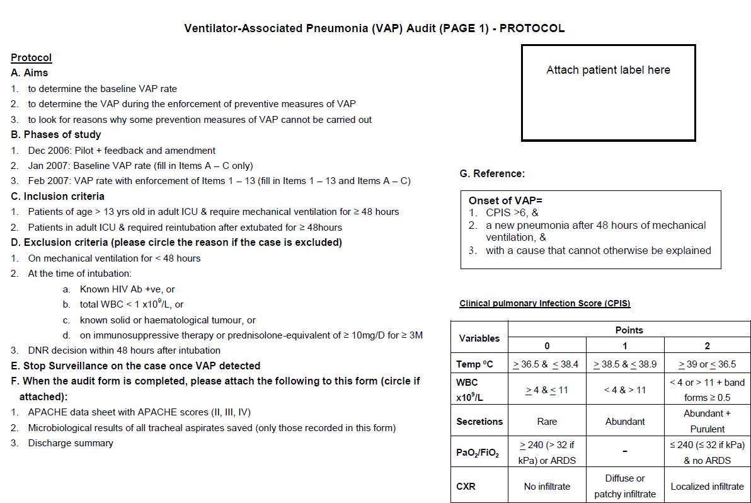
How did we deal with a high VAP rate and bring it down?
2007: First VAP Prevention Program

Slide 10
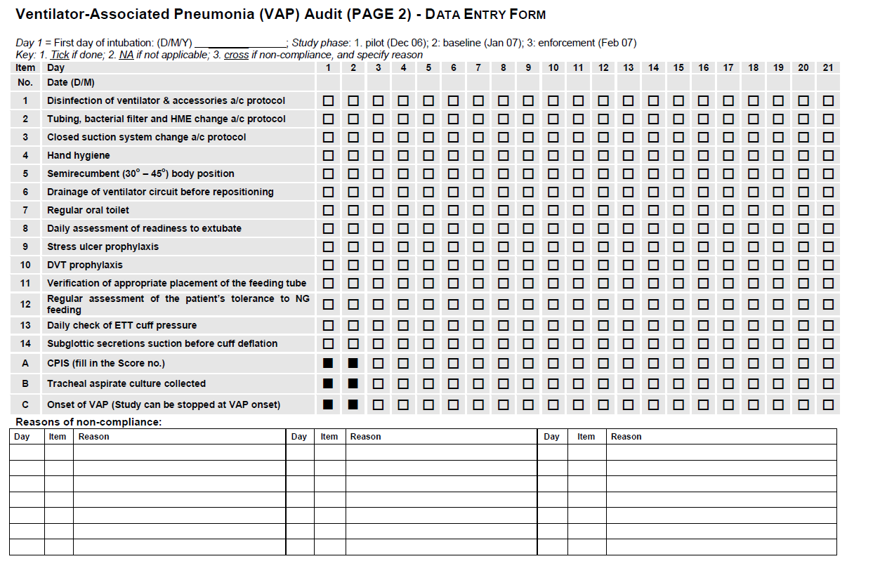

Slide 11

Results
Ventilator-days: Total: 264
VAP rate = 1 / 264 ventilator-days (projected: 3.8 per 1000)
Limitations:
  Patients prone to VAP excluded
  CPIS too specific for a dx of VAP
  Hawthorne effect
Impression: actual rate could be much higher …..

Slide 12
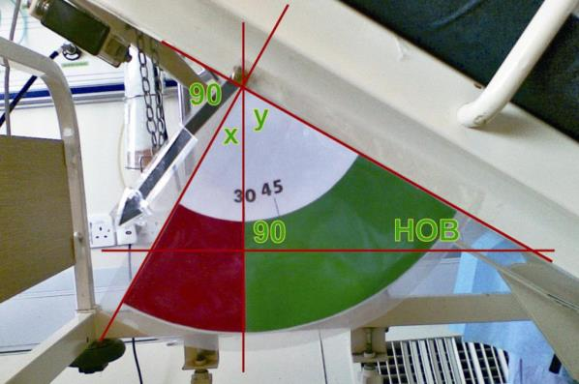
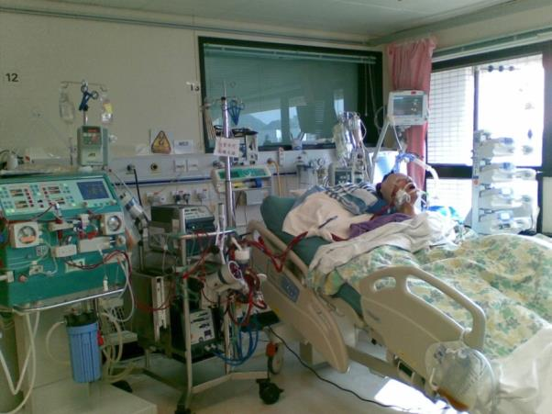
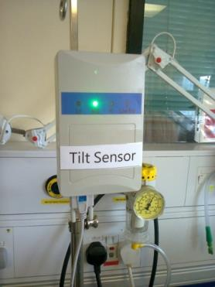
HOB angle indicator
Home-made HOB indicator
Ref: Williams, Zev MD, PhD; Chan, Rodney MD; Kelly, Edward MD. Critical Care Medicine 2008
Reverse Trendelenberg position if head of bed cannot be tilted
Tilt Senor: A collaboration with Polytechnic University: Green light signifies HOB within 30°-45°
Notes:
How we put these works into our daily practice of patient care

Slide 13
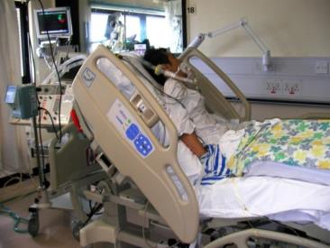
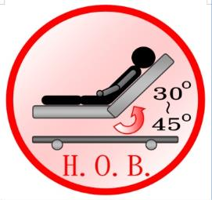
Re-examine Compliance to Maintain Bed Head Elevation
Desktop wallpaper
Target: ≥ 95% compliance
Notes:
Some tips

Slide 14
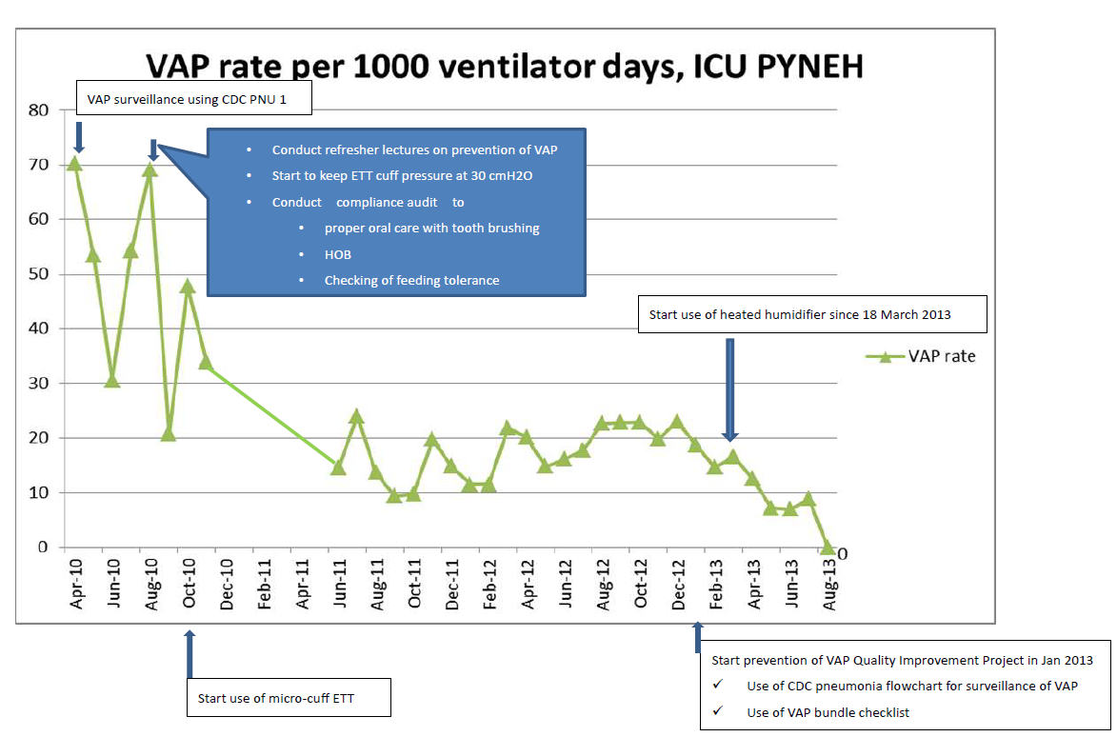
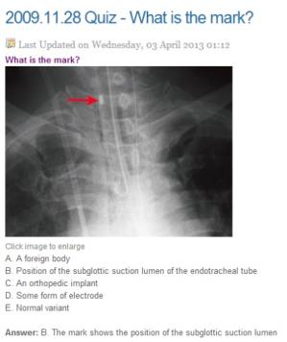


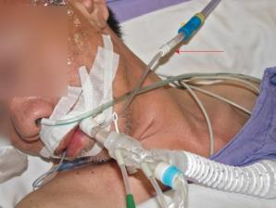
2009 - 2010: Ongoing VAP Audit
A CCM exit exam dissertation by Dr Arthur Kwan on VAP
Criteria: PNU1; Rate: 20 to 70 per 1000 ventilator-days
Refresher lectures on VAP prevention
Routine ETT cuff pressure checking
Compliance audits to: proper oral care with tooth brushing, Head of bed, Checking of feeding tolerance
Using novel ETT in clinical practice
  continuous aspiration of subglottic secretions (CASS)
  polyurethrane cuff
Idea generation for research on novel ETT comparison
Continuous monitoring of VAP rate

Slide 15
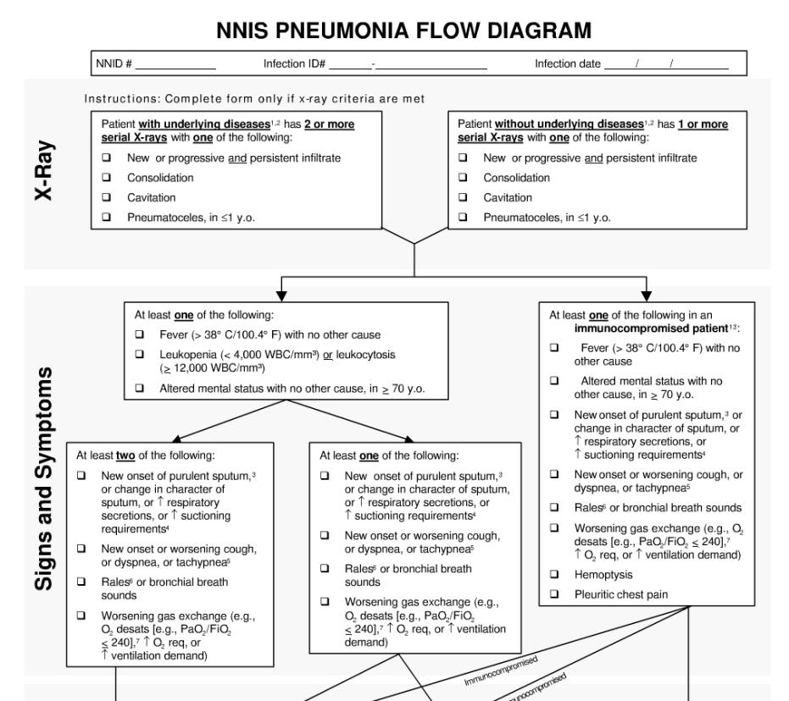
The PNU1 criteria

Slide 16
VAP Rate compared to NHSN Report 2011
Definition: CDC Pneumonia 2009 PNU 1 | VAP rate – pooled mean | VAP rate – upper 90% percentile
ICU PYNEH | Between 10 to 70
Medical/Surgical - Major teaching | 2.1 | 5.4
Medical Surgical - <= 15 beds | 1.1 | 4.3
Medical/surgical All other >15 beds | 1.0 | 2.8
Trauma | 4.7 | 13.5
Burn | 4.9 | 12.5
Numbers are per 1000 ventilator-days
Notes:
VUR = no of vent. Days /no. of pat. days

Slide 17
2012: VAP rate similar, rising?
Are you satisfied?

Slide 18
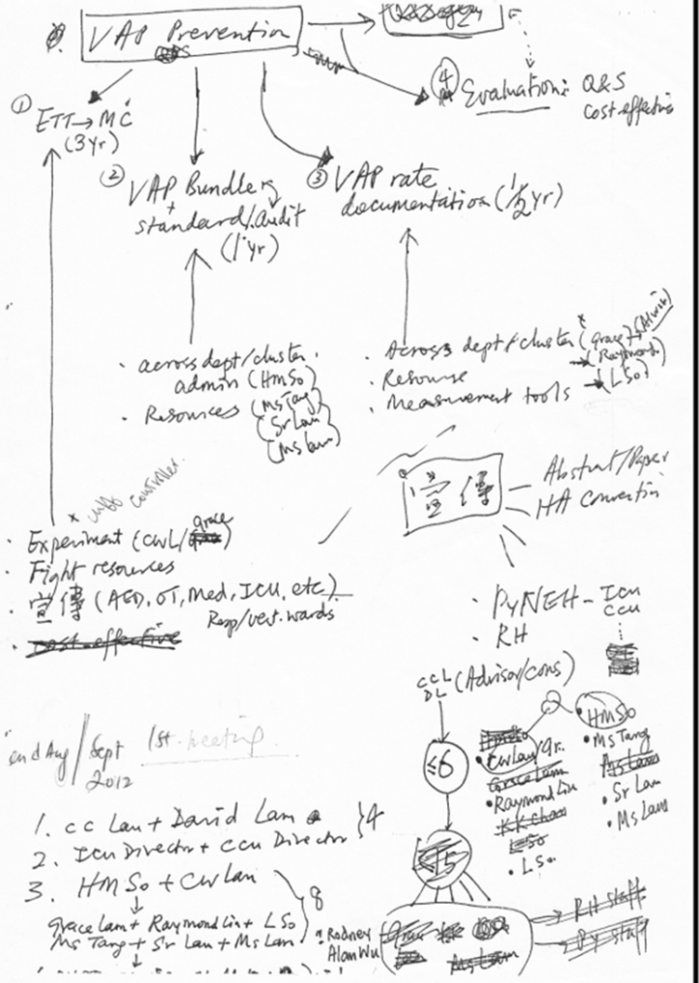
2012: Do something more …
But do what?
Multi-pronged approach to address all areas related to VAP prevention
Clinical
Administrative
VAP rate documentation
Education
Research
Promotion

Slide 19
VAP Prevention: administrative and clinical
Set up a Quality Improvement Project: VAP in Critical Care Areas of HKEC led by a Nurse Consultant
Set VAP as standing item in ICU business meeting
Continue the research to verify benefits of novel ETTs
Microcuff ETT use in whole ICU within 3 years
Promotion of use of novel ETT in all departments (AED, OT, Med, ICU)
VAP bundle standardization
Routine VAP rate documentation in HKEC: by all doctors
Regular VAP compliance audit

Slide 20
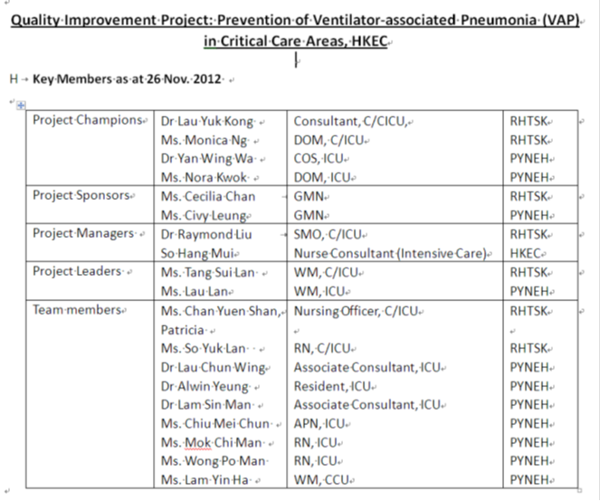
Quality Improvement Project: VAP in Critical Care Areas of HKEC
ICUs of PYNEH and RH joined

Slide 21
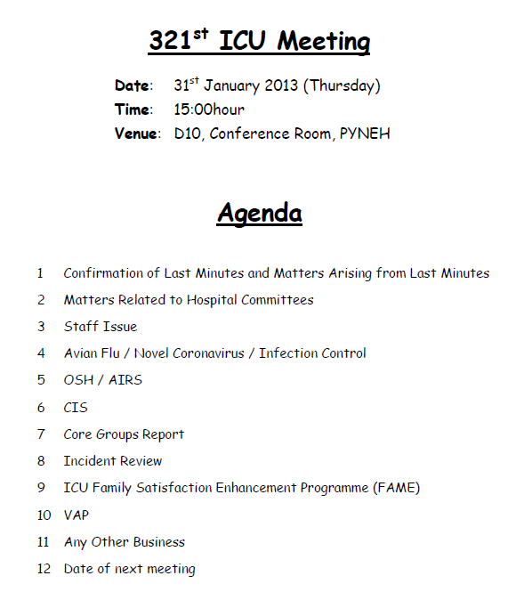
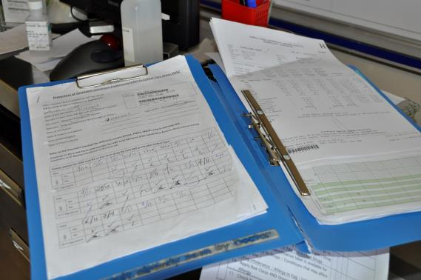
Administrative
VAP set as a standing agenda item in weekly ICU meeting
Routine VAP documentation by all doctors everyday

Slide 22
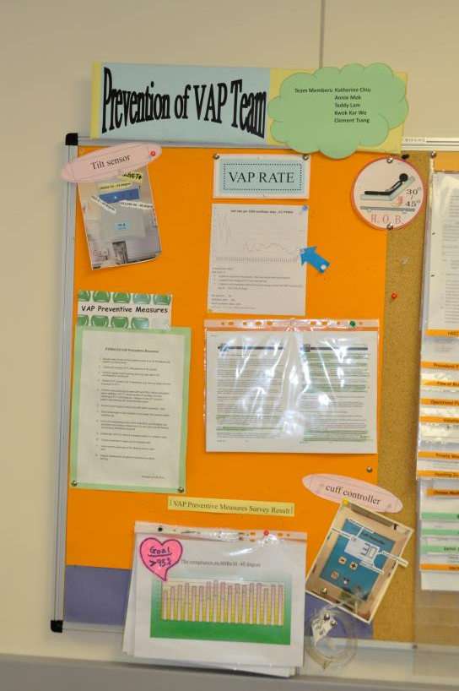
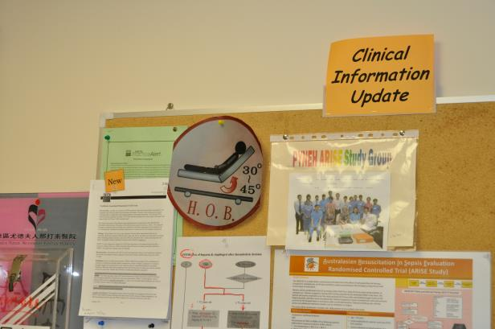
Outcome Evaluation
Monitor VAP rate at a monthly basis
Post up the VAP rate on display board at a prominent place
Disseminate compliance audit results

Slide 23

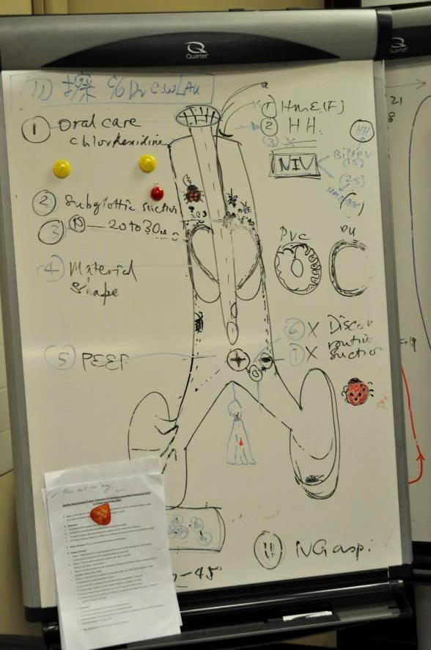
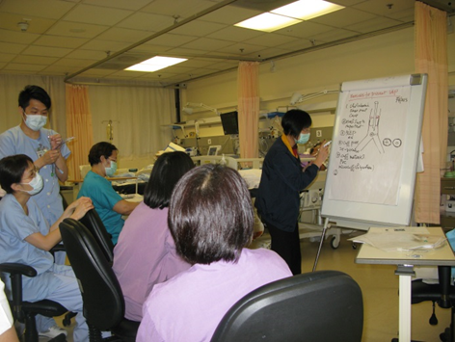
Education
Refresher lecture on VAP
Repeated brief talks at bedside
Visual display for better promotion
Notes:
Use HH

Slide 24
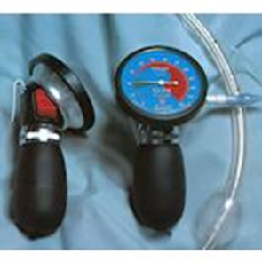
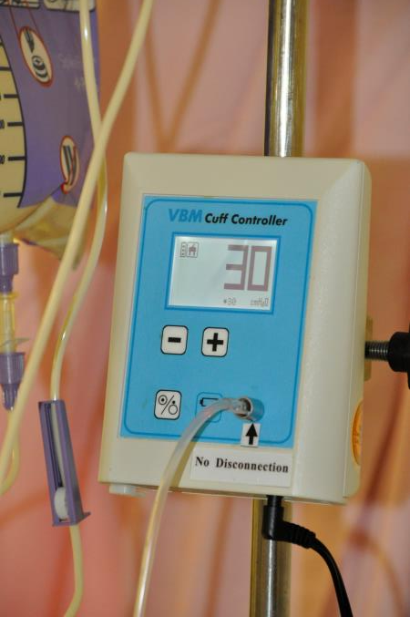
Intermittent to continuous cuff pressure monitoring and maintenance device
Notes:
Use HH

Slide 25
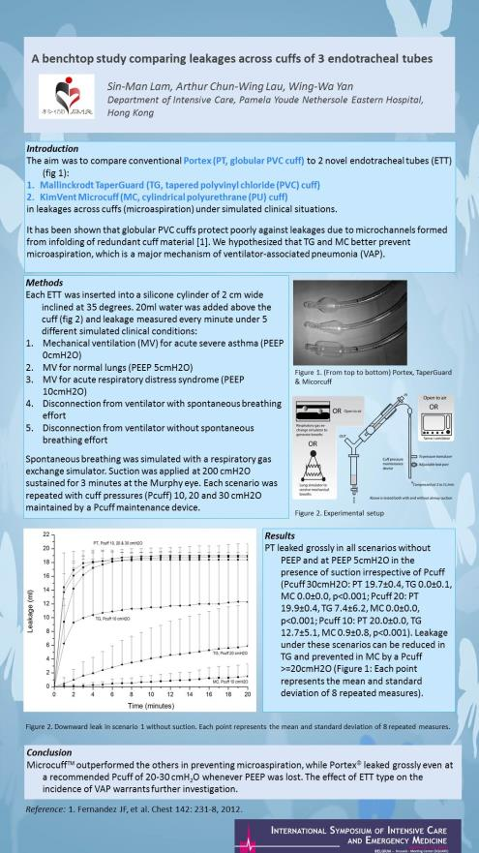
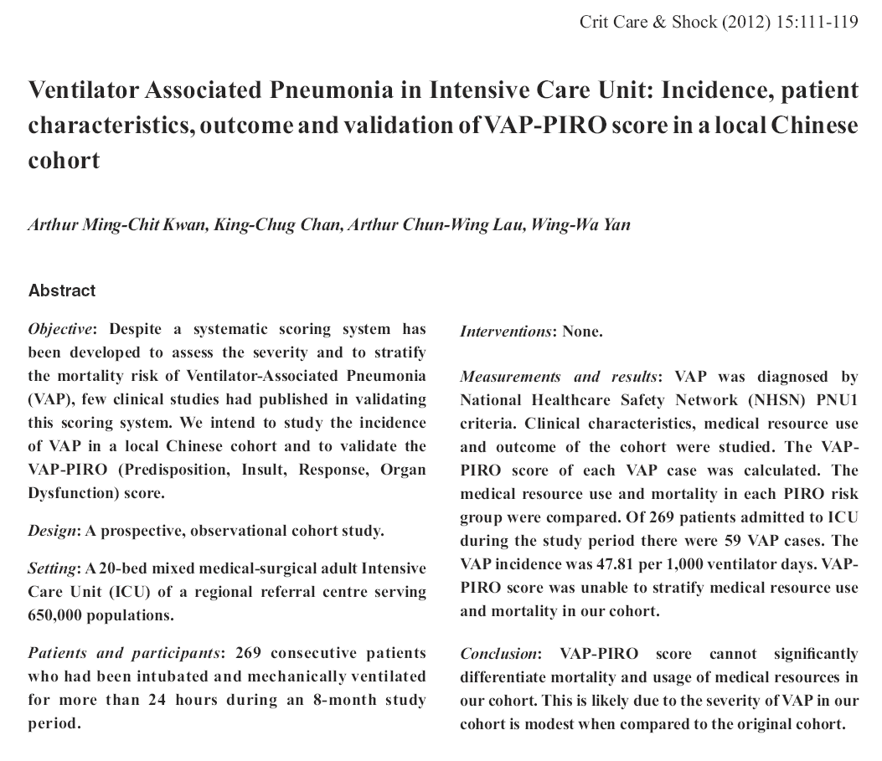
Research
Ref: Kwan AMC, et al. Crit Care & Shock 2012
Ref: Lam SM, Lau ACW. ISICEM 2013 Abstract

Slide 26
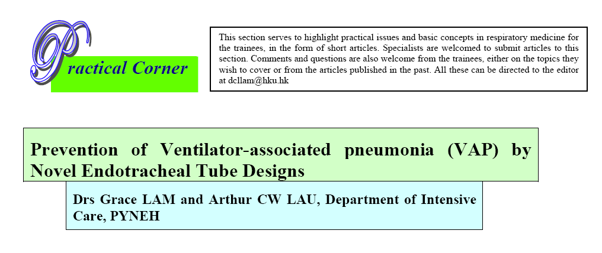
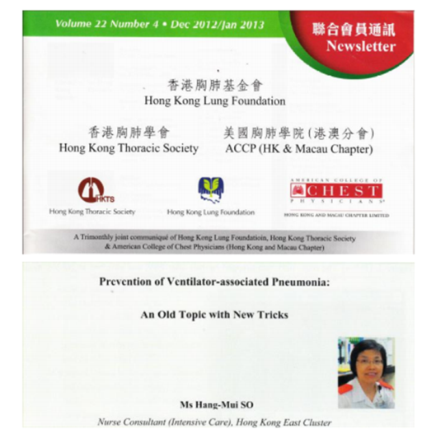


Education and Knowledge dissemination
Articles on Prevention of VAP
  Prevention of Ventilator-associated pneumonia (VAP) by Novel Endotracheal Tube Designs. Drs Grace LAM and Arthur CW LAU. HKTS Newsletter 2011 May.
  Prevention of Ventilator-associated pneumonia - An Old Topic with New Tricks. SO HM, HKTS Newslettter Jan 2013
Also Freely available at
  Hong Kong Resp Med: www.hkresp.com
  Hong Kong Society of Critical Care Medicine: www.hksccm.org

Slide 27

ICU Specialist Infection Control Training Program
16 April 2013

Slide 28
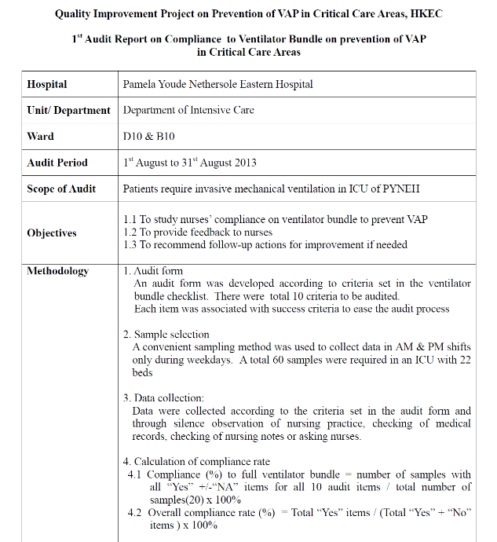
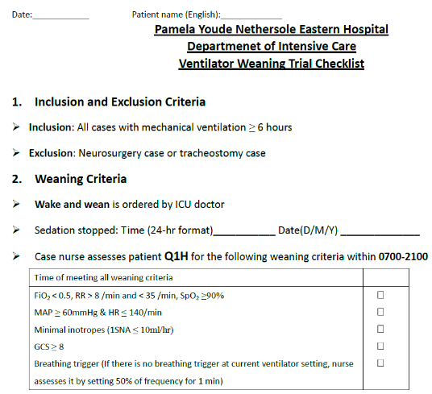
Prevention of VAP Team (nurse-led)
Regular audit
Ventilator Weaning Trial
Ventilator weaning trial (Nov 2013)
Audit on compliance to VAP bundle (Aug 2013)

Slide 29
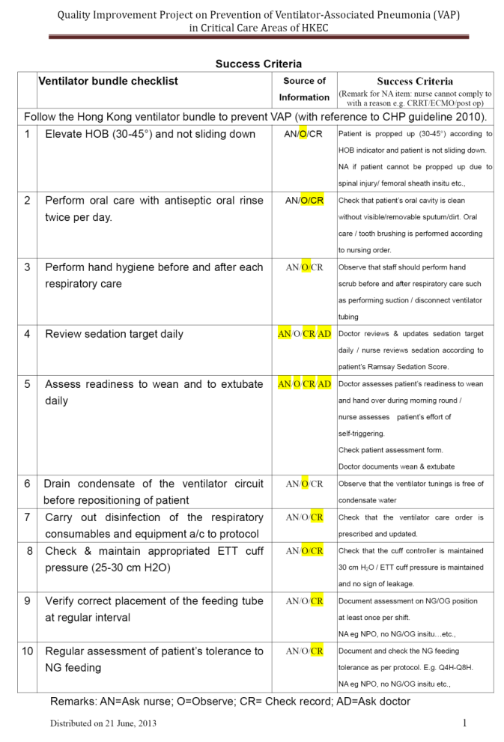
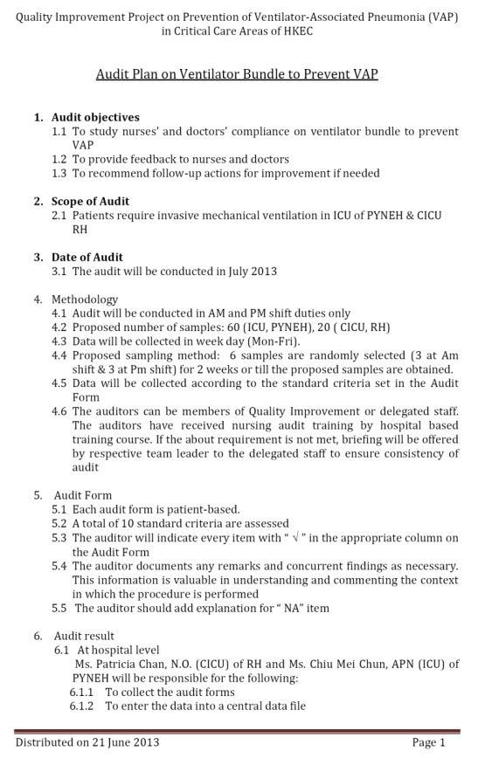
Compliance Audit

Slide 30
Audit findings
N = 60
Rate of full (100%) compliance to VAP bundle: 53.3%
Average compliance of all items 92.95%
Compliance rates <95% in:
  Drain condensate of the ventilator circuit before repositioning of patient (71.4%)
  Perform hand hygiene before and after each respiratory care (81.7%)
  Review sedation target daily (87.8%)

Slide 31
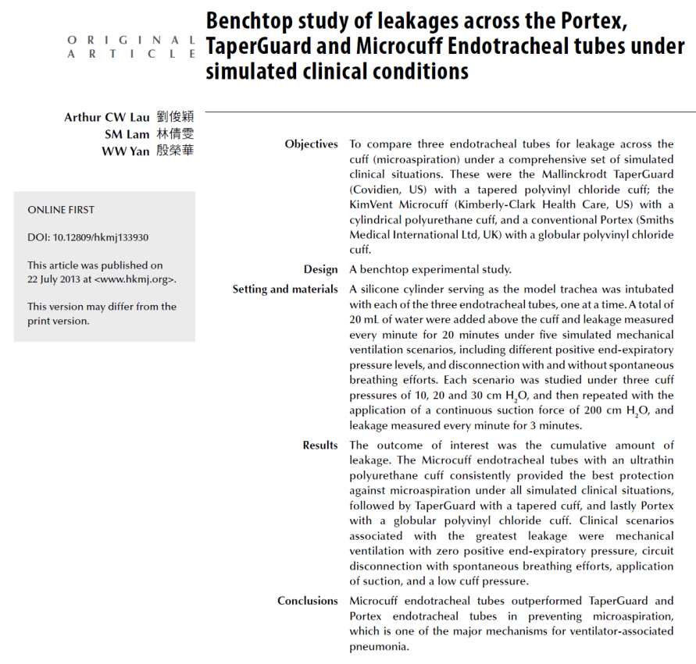
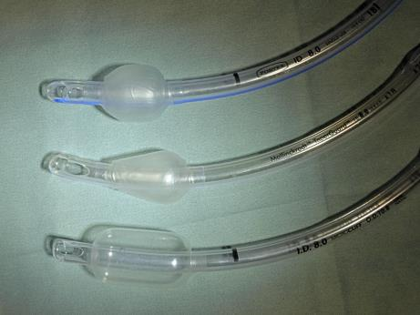
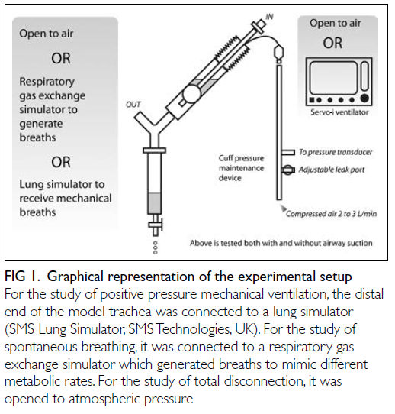
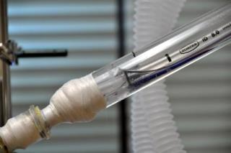
Results of a recent research of our group on novel ETT
Ref: Lau ACW, Lam SM, Yan WW. HKMJ 2013

Slide 32
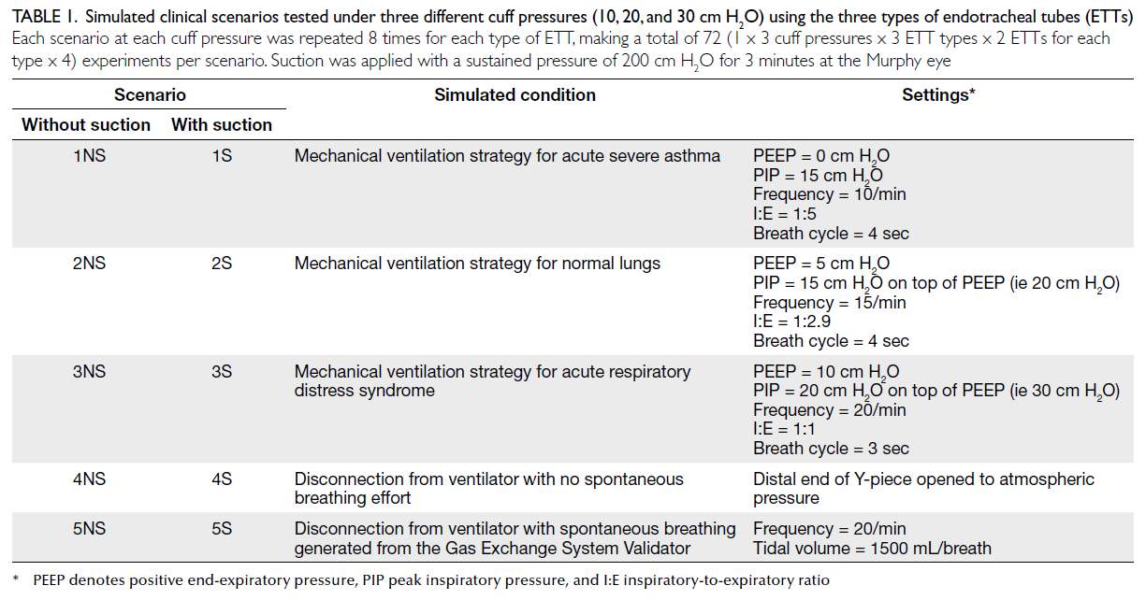
Simulated clinical scenarios under three different cuff pressures (10, 20 and 30 cmH2O)

Slide 33


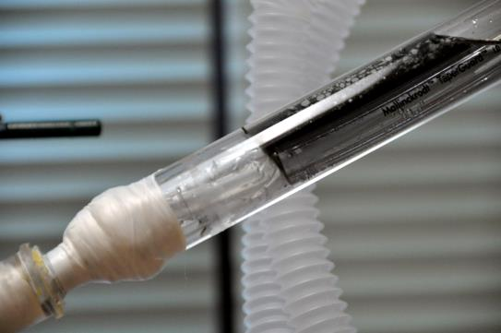
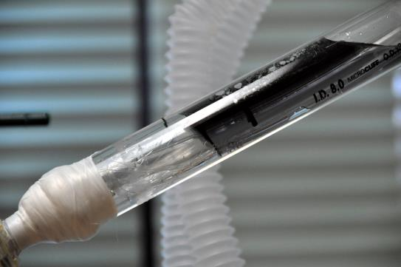
Presented at the Medical-ICU Audit Meeting at the Department of Medicine, PYNEH
Portex
TaperGuard
Microcuff

Slide 34
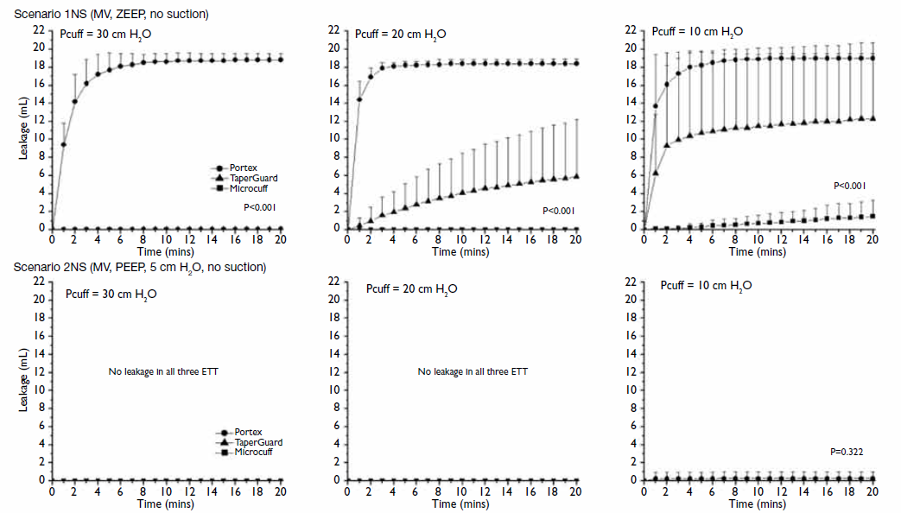
No suction
Importance of PEEP and Pcuff
Type of ETT

Slide 35
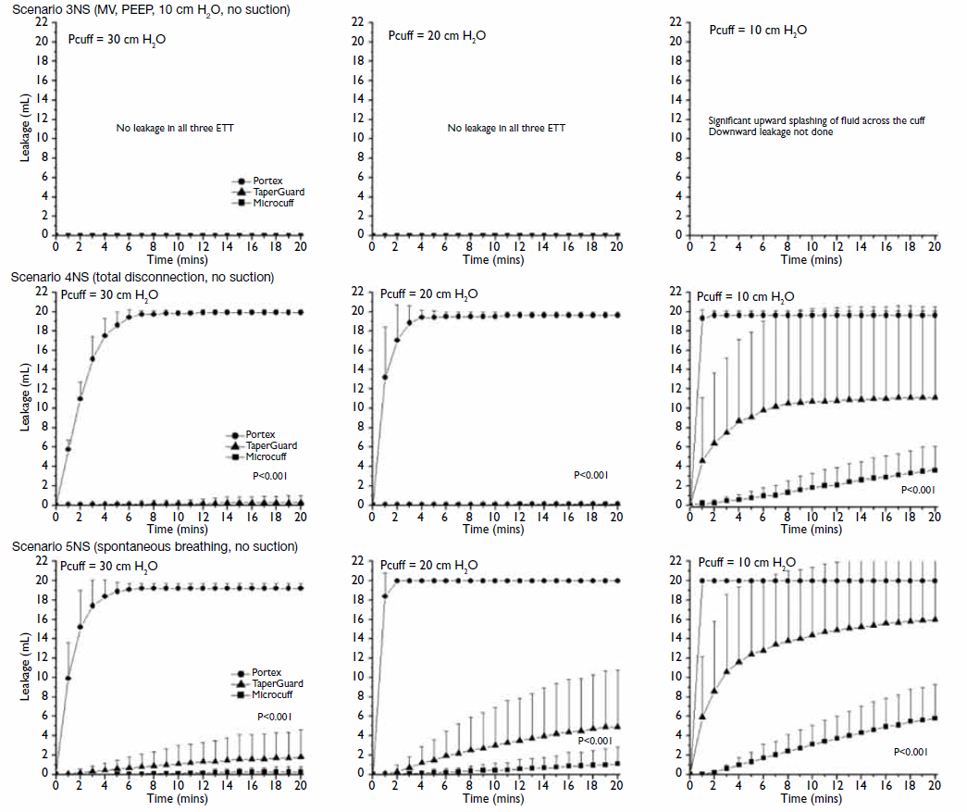



Slide 36
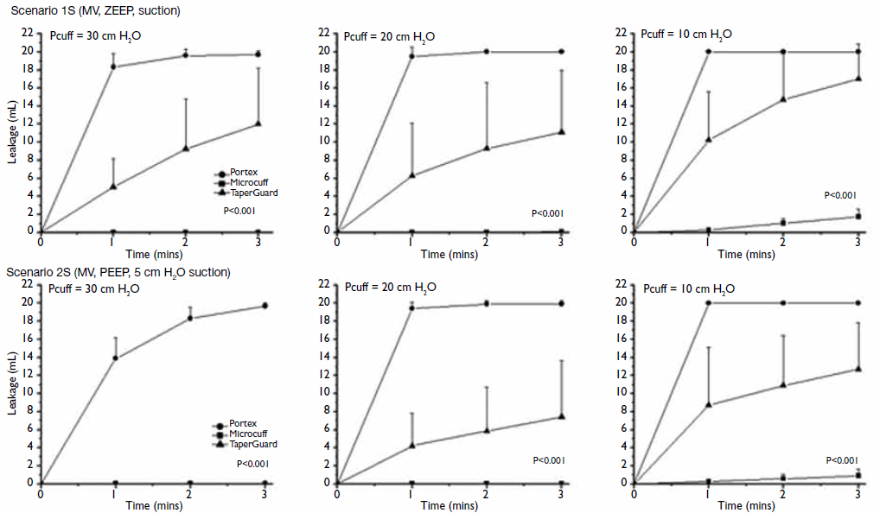
With suction
Suction eliminates the protective effect of PEEP 5

Slide 37
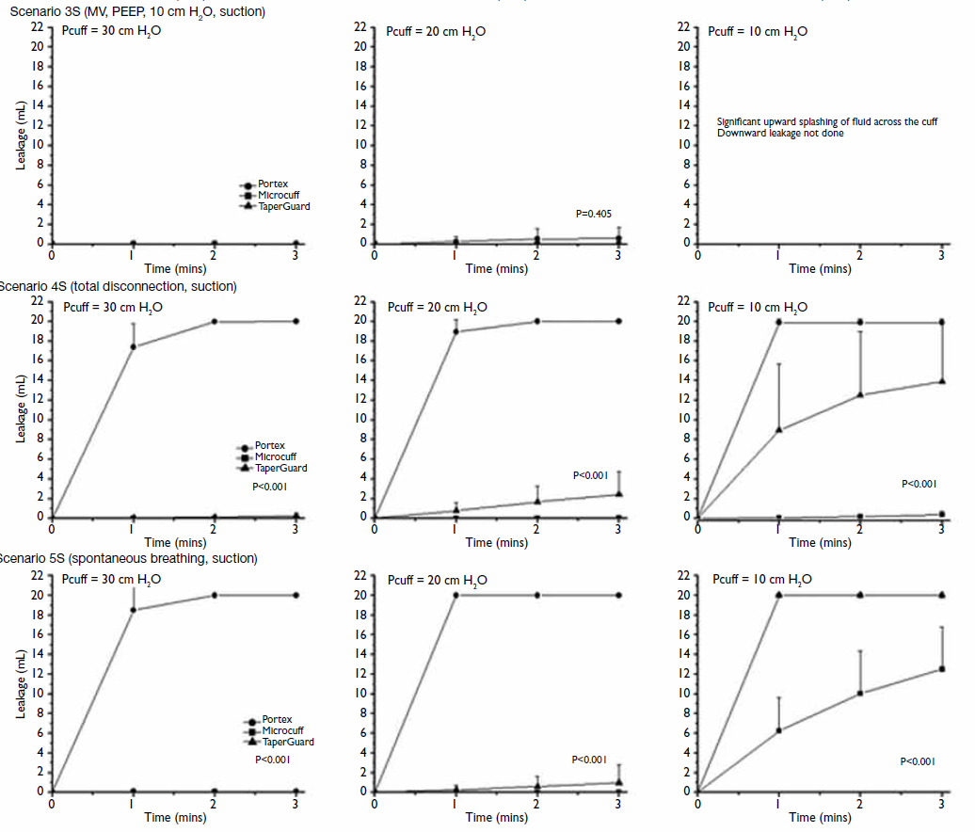

Slide 38
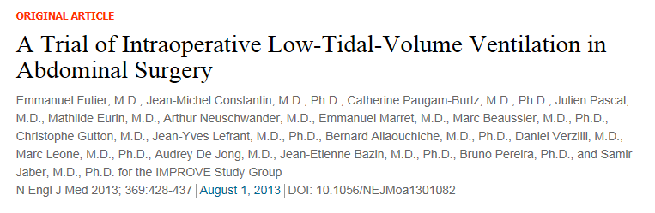
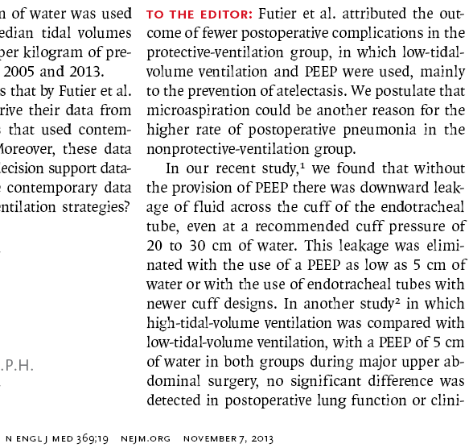
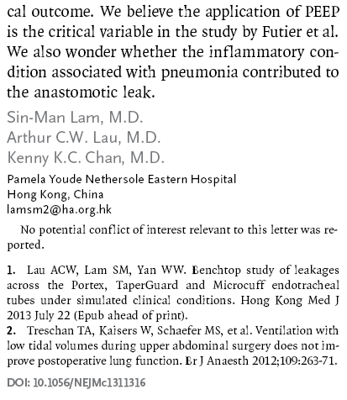
Letter to the NEJM Editor on this article:

Slide 39
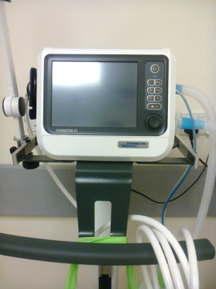
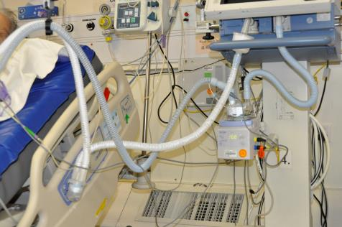

To do more …..
Promote minimal disconnection of ventilator circuit
  Use of heated humidification instead of HME
  Perform ETT suction only as needed
  Perform oropharyngeal suction at regular interval and before disconnection of ventilator circuit
  Trial use of Hamilton ventilators (can be used for transport)
Notes:
Use HH

Slide 40
2013: VAP rate
Quoted as a Clinical Audit Example in the UK Audit Report 2013 (p 68): “… the ICU also records the interventions introduced at alert points, and then monitors whether audit results improve …”

Slide 41

Sep 2013
Are you satisfied?
Start individual VAP case review:
2 patients required reintubation. VAP was noted after reintubation.
1 patient had change of ETT intra-operatively.
1 patient with respiratory failure and post cardiac arrest had VAP noted on ICU day 21 (ICU LOS: 25 days)
MV patients : 58; Ventilator days: 233; Mean ventilator days : 4.02; VAP rate : 17.17 per 1000 ventilator days

Slide 42
Literature review
Results by year (1997 – 2013) in Medline – “Ventilator Associated Pneumonia”

Slide 43
Recent studies
Topic | Journal | Results
Leptin level in dx VAP | Minerva Anestesiol. 2013 Oct 9 | No significant difference was found in leptin and PCT levels between cases and controls. CRP level was significantly higher on the day of VAP in cases compared with controls
Statin on VAP mortality | JAMA. 2013 Oct 23;310(16):1692-700 | In adults with suspected VAP, adjunctive simvastatin therapy compared with placebo did not improve day-28 survival. These findings do not support the use of statins with the goal of improving VAP outcomes.
Oropharyngeal Povidone-Iodine Preventive Oral Care on VAP | Crit Care Med. 2013 Oct 7. | There is no evidence to recommend oral care with povidone-iodine to prevent ventilator-associated pneumonia in high-risk patients. Furthermore, this strategy seems to increase the rate of acute respiratory distress syndrome.
Effect of aerosolized colistin as adjunctive treatment VAP | Chest. 2013 Aug 29 | Aeorosolized colistin might be a beneficial adjunct to IV colistin in the management of VAP caused by colistin-only susceptible GNB
Effectiveness of different concentrations of chlorhexidine for prevention of VAP: A meta-analysis. | J Clin Nurs. 2013 Aug 19 | Chlorhexidine of 0·12% is recommended
rapid diagnostic test (Cepheid Xpert assay) in patients with suspected VAP | Crit Care. 2013 Aug 6;17(4):R170. | On BAL or miniBAL sample, gold standard: quantitative culture; The test was not interpretable in 41 (9.3%) cases. The negative predictive values of the rapid detection test were 99.7% [98.1-99.9] and 99.8% [98.7-99.9] for MSSA and MRSA, respectively.
Relationship between nasal colonization and VAP | Am J Infect Control. 2013 Jul 23. | Nasal colonization for S aureus is a risk factor for development of VAP

Slide 44
Topic | Journal | Results
Oral topical decontamination for preventing ventilator-associated pneumonia: a systematic review and meta-analysis of randomized controlled trials. | J Hosp Infect. 2013 Aug;84(4):283-93 | Oral decontamination reduced the incidence of VAP in adults undergoing ventilation, but did not affect all-cause mortality, duration of ventilation, or duration of ICU stay in ventilated patients.
Pre-emptive broad-spectrum treatment for ventilator-associated pneumonia in high-risk patients. | Intensive Care Med. 2013 Sep;39(9):1547-55 | the intervention group, which received a 3-day course of linezolid and meropenem, and the control group, which received the standard of care. The main outcome was the development of VAP or VAT: may be effective in reducing the incidence and delaying the onset of VAP + VAT after MHS.
Short- versus long-duration antibiotic regimens for ventilator-associated pneumonia: a systematic review and meta-analysis. | Chest. 2013 Jun 20 | our randomized controlled trials(RCTs) comparing short(7-8 days) with long(10-15 days) regimens were identified. Short-course treatment for VAP was associated with more antibiotic-free days. No difference was found regarding mortality and relapses; however a strong trend for less relapses was observed in favor of the long-course treatment,
Design and construction of a single tube, quantitative endpoint, LATE-PCR multiplex assay for VAP (quantitative detection and identification of pathogen genomic DNA of MRSA, Acinetobacter baumannii, Pseudomonas aeruginosa, plus a control target from Lactococcus lactis) | J Appl Microbiol. 2013 Sep;115(3):818-27. | This assay is rapid, reliable and sensitive and is ready for preclinical testing using samples recovered from patients suffering from ventilator-associated pneumonia.
Effect of not monitoring residual gastric volume on risk of ventilator-associated pneumonia in adults receiving mechanical ventilation and early enteral feeding: a randomized controlled trial. | JAMA. 2013 Jan 16;309(3):249-56. | Among adults requiring mechanical ventilation and receiving early enteral nutrition, the absence of gastric volume monitoring was not inferior to routine residual gastric volume monitoring in terms of development of VAP.

Slide 45
Azithromycin attenuates lung inflammation in a mouse model of ventilator-associated pneumonia by multidrug-resistant Acinetobacter baumannii. | Antimicrob Agents Chemother. 2013 Aug;57(8):3883-8. | The treatment groups displayed significantly longer survival than the control group (P < 0.05). AZM did not have an antimicrobial effect. Histopathological examination of lung specimens indicated that the progression of lung inflammation was prevented in the AZM-treated groups. Furthermore, total cell and neutrophil counts, as well as cytokine levels, in bronchoalveolar lavage fluid were significantly decreased (P < 0.05) in the AZM-treated groups.
Efficacy of single-dose antibiotic against early-onset pneumonia in comatose patients who are ventilated. | Chest. 2013 May;143(5):1219-25 | a single-dose of antibiotic within 4 h of intubation: The global incidence of VAP and incidence of EO-VAP were lower in the prophylaxis group: 10.8 vs 28.4 episodes/1,000 days on mechanical ventilation (P = .015) and 4.4 vs 23.1 episodes/1,000 days on mechanical ventilation (P = .02), respectively. The incidence of late-onset VAP did not differ.
Does Low-Dose Hydrocortisone Therapy Prevent Ventilator-Associated Pneumonia in Trauma Patients? | Am J Ther. 2013 May 21. | The incidence of VAP was not different between the 2 studied groups (29.3% and 26.5%; P = 0.676).
A comparison of Listerine® and sodium bicarbonate oral cleansing solutions on dental plaque colonisation and incidence of ventilator associated pneumonia in mechanically ventilated patients: a randomised control trial. | Intensive Crit Care Nurs. 2013 Oct;29(5):275-81. | Compared to the control group, Listerine(®) or sodium bicarbonate oral rinses were not more effective in the reduction of colonisation of dental plaque or the incidence of VAP.
Comparison of 8 vs 15 Days of Antibiotic Therapy for Ventilator-Associated Pneumonia in Adults A Randomized Trial | JAMA. 2003;290(19):2588-2598. | Among patients who had received appropriate initial empirical therapy, with the possible exception of those developing nonfermenting gram-negative bacillus infections, comparable clinical effectiveness against VAP was obtained with the 8- and 15-day treatment regimens. The 8-day group had less antibiotic use.

Slide 46
Small bowel feeding and risk of pneumonia in adult critically ill patients: a systematic review and meta-analysis of randomized trials. | Alhazzani W, et al. Crit Care. 2013 Jul 2;17(4):R127. [Epub ahead of print] | Small bowel feeding compared to gastric feeding was associated with reduced risk of pneumonia (risk ratio [RR] 0.70; 95% CI, 0.55, 0.90; P=0.004; I2=0%) and ventilator-associated pneumonia (RR 0.68; 95% CI 0.53, 0.89; P=0.005; I2=0%), with no difference in mortality, length of ICU stay, duration of mechanical ventilation , gastrointestinal bleeding, aspiration, and vomiting. The overall quality of evidence was low for pneumonia outcome.
Oral hygiene regimes for mechanically ventilated patients that use chlorhexidine reduce ventilator-associated pneumonia. | Richards D. Evid Based Dent. 2013 Sep;14(3):91-2. | OHC that includes either chlorhexidine mouthwash or gel is associated with a 40% reduction in the odds of developing ventilator-associated pneumonia in critically ill adults. However, there is no evidence of a difference in the outcomes of mortality, duration of mechanical ventilation or duration of ICU stay. There is no evidence that OHC including both CHX and toothbrushing is different from OHC with CHX alone, and some weak evidence to suggest that povidone iodine mouthrinse is more effective than saline in reducing VAP. There is insufficient evidence to determine whether powered toothbrushing or other oral care solutions are effective in reducing VAP.
Toothbrushing may reduce ventilator-associated pneumonia. | Yusuf H. Evid Based Dent. 2013 Sep;14(3):89-90. | randomised trials to date show that toothbrushing is associated with a trend toward lower rates of VAP in intubated, mechanically ventilated critically ill patients. There is no clear difference between electric and manual toothbrushing. Toothbrushing has no effect on ICU mortality, hospital mortality, or ICU length of stay.

Slide 47






Effect of continuous oral suctioning on the development of ventilator-associated pneumonia: a pilot randomized controlled trial.
The aim of this pilot randomized controlled trial was to test the effect of a low-cost device (saliva ejector) for continuous oral suctioning (COS) on the incidence of VAP in patients receiving mechanical ventilation.
VAP was found in 3 patients (23.1%; 71 episodes of VAP per 1000 ventilation days) receiving COS and in 10 patients (83.3%; 141 episodes of VAP per 1000 ventilation days) in the control group (relative risk, 0.28; 95% confidence interval, 0.10-0.77; p=0.003).
Chow MC et al. Int J Nurs Stud. 2012

Slide 48
Intermittent suction of oral secretions before each positional change may reduce ventilator-associated pneumonia: a pilot study.
METHODS: The study consisted of a 9-month observation phase (control group, 237 patients), a 6-month education phase, followed by a 7-month intervention phase (studied group, 227 patients).
RESULTS:
VAP occurred less frequently in the studied group (6 of 227 patients, 2.6%) than in the control group (26 of 237 patients, 11.0%; P < 0.001).
The incidence rate of VAP in control and studied groups was 6.51 and 2.04 per 1000 ventilator days, respectively (P = 0.002).
CONCLUSIONS: Intermittent suction of oral secretions before each positional change may reduce VAP occurrence in ICU patients.
Tsai HH, Lin FC, Chang SC. Am J Med Sci. 2008

Slide 49


Biofilm removal: EndoClear Catheter Device
PURPOSE: To compare the effectiveness of removing adherent endotracheal tube secretions with the use of the EndOclear catheter prior to weaning trials compared to the effects of routine suctioning prior to weaning trials.
METHODS: This is a two year retrospective study.
RESULTS: 550 cases were reviewed during 2011 and 562 cases in 2012. Previous to the initiation of endotracheal tube being cleared with the EndoClear catheter ventilator days were 4.3, ICU LOS was 5.2, and hospital LOS was 9.3. After the initiation of the EndOclear tube there was a decrease in ventilator days by 1 day. ICU LOS decreased from 9.3 by 0.9 days and the hospital LOS decreased from 5.2 by 1 day. Our VAP rate went from 1.2 in 2011 to 0 in 2012 and continues to remain at 0.
IMPLICATIONS: Utilizing the EndOclear catheter is a safer, more effective way to remove adherent secretions and biofilm on the endotracheal tube then routine suctioning technique resulting in decreased time on the ventilator.
Manufactured by EndOclear LLC (San Ramon, CA). Entry submitted by Innovative Design LLC (Danvill, CA). Supply and design credit to JG Plastics Group LLC (Costa Mesa, CA), Hiemstra Product Development LLC (San Francisco).
The endOclear is a sterile, single-use wiper that clears away secretions and biofilm from inside the endotracheal tube (ETT) and provides visualization inside the ETT.
Ref: Schofield L, Saurs G. Chest. 2013 Oct 1;144(4_MeetingAbstracts):64A.

Slide 50


Future: Ventilator-Associated Event (VAE)
?automated capture using CIS

Slide 51



The Clinical Impact and Preventability of Ventilator-Associated Conditions in Critically Ill Patients Who Are Mechanically Ventilated
Retrospective review of 1320 patients
The agreement between VAP and VAC was 0.18, and between VAP and iVAC it was 0.19.
Although the agreement between VAC, iVAC, and VAP is poor, a higher adoption of measures to prevent VAP was associated with lower VAP and VAC rates.
John Muscedere, et al,; on behalf of for the Canadian Critical Care Trials Group. Chest. 2013

Slide 52
Summary of strategies
Clinical | VAP bundle + further refinement to reduce microaspiration and biofilm formation
Administrative | Task Force Meeting agenda item Novel ETT in all departments Bring in new technology Continual amendment of protocols to facilitate development Review each case of VAP VAP rate as KPI
VAP rate documentation | Continual evaluation Assess merits of using VAE
Education | Boards, Newsletters, Websites, Talks, Lectures
Research | Continue research and literature review Update the above regularly to bring in new strategies Both evidence-based and pragmatic approaches

Slide 53
Acknowledgment
Ms HM So, Nurse Consultant, ICU, PYNEH and Task Force members
All staff of PYNEH and RH C/ICU

Slide 54
Thank you!

